Slide 1
Smart Door Lock and Lighting System Using Internet Of Things

Slide 2
Contents
Introduction
Objectives
Components
Working
Methodology
Conclusion

Slide 3
Introduction
Internet of Things
A smart door lock and lighting system using IOT for smart home is presented with the additional add on feature of facial recognition.
The user can remotely control the gate, home appliances, etc comfortably and conveniently anywhere and anytime.

Slide 4
Objectives
The main objective of this project is to provide remote access to door lock and lighting system.
Smart lighting: The remote lighting system allows user to remotely control lighting i.e. switching it ON / OFF and also vary the intensity of light.
Door Lock: This project also ensures that the user need not worry about whether the door is left unlocked or not and hence ensures peace of mind for the user.
Facial Recognition:
This is an additional add-on feature is implemented in this project. This feature is enabled for the door locking and unlocking system, which also imbibes a sense of security.

Slide 5
Main Components
12V Battery
Voltage regulator
Raspberry pi zero
Relays
Camera module

Slide 6
Project Methodology
Blynk App-Open source IoT app.
Raspberry pi module zero.

Slide 7
Battery
Voltage regulator
Camera
Raspberry zero pi
Switch
Key pad
Relay Board
Lock
Bulb
Fan
TV

Slide 8
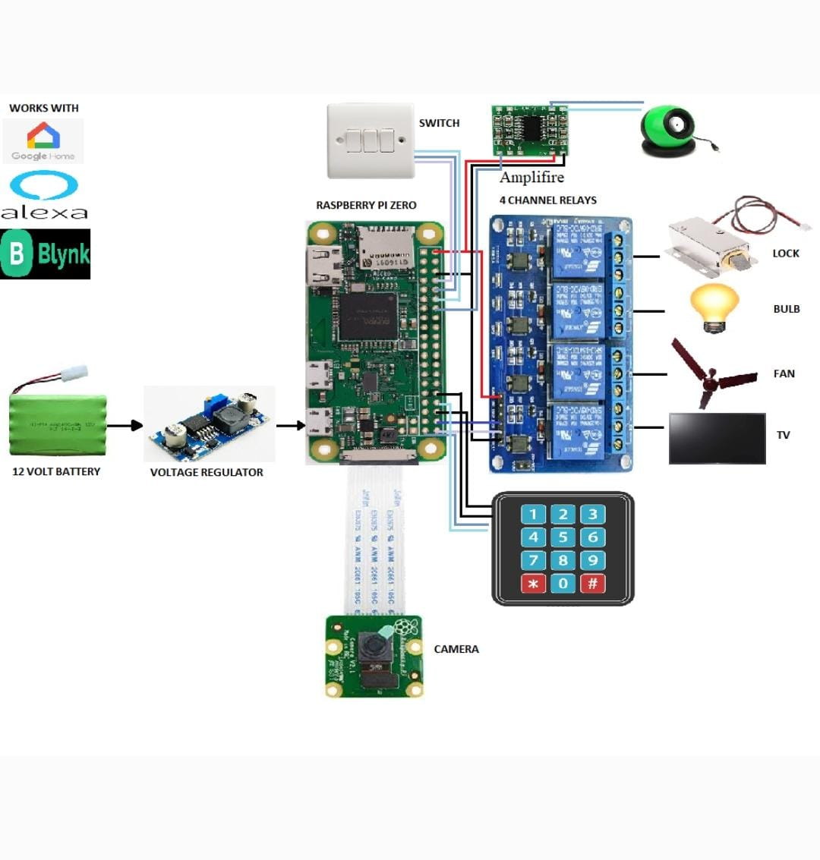

Slide 9
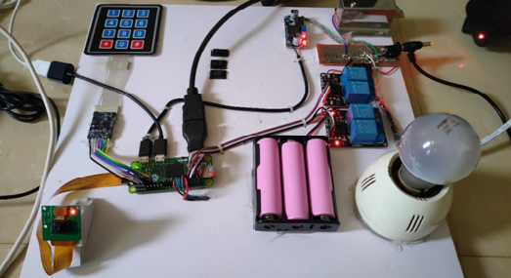

Slide 10
Conclusion
Smart door lock system based on RASPBERRY PI which includes camera module and keypad facilities, which integrates home security with home automation is implemented.
Since our proposed system is built over wireless sensor network, it is cheap and flexible and can be easily installed.

